Slide 1
《英语国家社会与文化入门》(下册）
The Society and Culture
of Major English-Speaking Countries
An Introduction
(Book Two)

Slide 2
Canada Unit 20 The Canadian Economy
Welcome to Canada Bienvenue au Canada

Slide 3
Quiz
Give the English and a brief explanation for the following:
1 国内生产总值
2 “增值”产业
3 第三产业
4 美加《自由贸易协定》
5 “第三种选择”

Slide 4
Focal Points
three factors influencing Canadian economy
The Canada-US Free Trade Agreement
natural resources in Canada
agriculture in Canada
manufacturing industry in Canada
service industry in Canada

Slide 5
This Unit Is Divided into Seven Sections
History
The Canada-US Free Trade Agreement
Natural Resources
Agriculture
Manufacturing Industries
Service Industries
Canada’s Place in the World Economy

Slide 6
Overview
A leading industrial nation with a highly developed economy
Factors influencing the economy
1. its physical geography -- rich in natural resources with
huge size and small population, therefore extracting and
transporting difficult
2. the U.S. – more powerful economy and larger market,
therefore trade developed more across the border than
within the country
3. federal government have played a stronger role in managing
the development of resources and infrastructure

Slide 7
Three main industries:
natural resources (primary industries)
manufacturing (secondary industries)
service (tertiary) industries

Slide 8
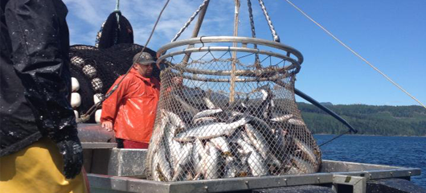
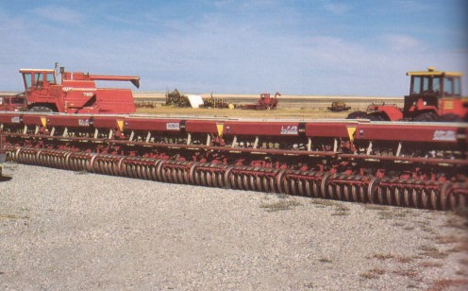
Natural resources (primary industries) -- 6% of Canada’s GDP
agriculture
fishing
forestry
mining

Slide 9
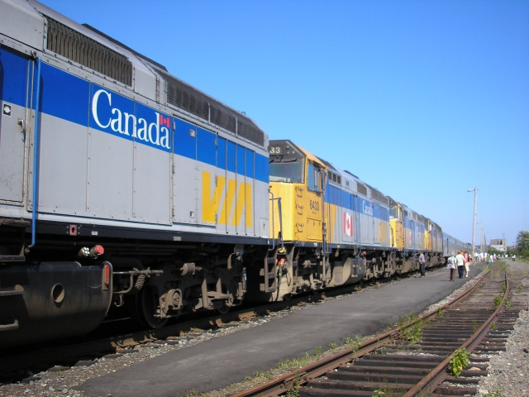
Manufacturing (secondary industries) -- 26% of GDP
manufacturing
construction
transport
communications

Slide 10
Service (tertiary) industries -- 68% of GDP
Trade
Finance
Services
public administration

Slide 11
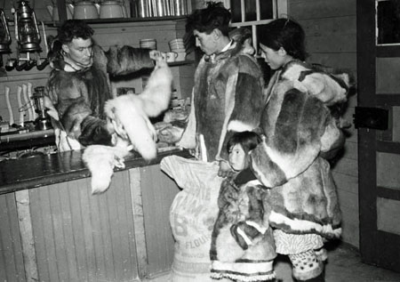
Before WW II
a producer of staple commodities -- furs, fish, forestry and agricultural products
export of primary resources -- the backbone of the economy
John A. Macdonald attempted to develop internal markets and a manufacturing industry but failed

Slide 12
After WW II
ties with the UK weakened, and more influenced by the US
growth remained based on raw materials
the extent of foreign ownership of companies was high
small market and difficult to access
difficult to compete with US manufacturers
protectionist practices to stimulate manufacturing industries, eg, heavy tariffs on the import of US cars

Slide 13
In the 1960s & 1970s
Auto Pact (Canada and U.S.) signed in 1965, paved way for FTA
After 1966, affected by US inflation, world oil crisis of early 1970s, and economic recession of 1974-75
Trudeau’s new economic vision – floating exchange rate, imposing export tax on oil, “Third Option” (stronger trading relations with Japan and Europe rather than relying too much on the US) – policies worked well, but viewed as being socialist and interventionist

Slide 14
In 1980 and after
National Energy Policy (1980) –
-- controversial attempt to control of the energy industry
-- angered western provinces
End of government interventionism, embrace the principles of free trade

Slide 15
II. The Canada-US Free Trade Agreement
Background
Brian Mulroney broke promise after coming into office in 1984, started negotiating free trade with US
Canadian industries had been hurt by the US’ refusal to regard Canada as a “special case” and waive tariffs
Businesses were relocating to the US
the US hoped to gain more international support for GATT

Slide 16
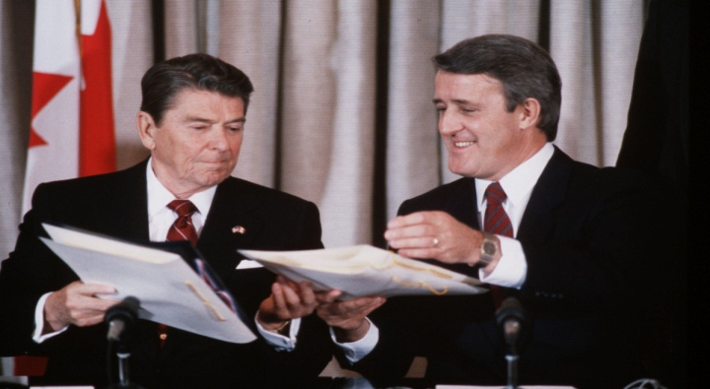
The FTA
came into effect on 1 January 1989
scheduled to remove tariff protection on most items by 1998
Controversial agreement on agricultural products
controversial provision of a guarantee of the US’ access to Canadian energy
cultural activities and beer – left out of the agreement

Slide 17
Effects of FTA
a reduced role of government in the
benefited resource-rich western provinces more than the heavily-manufacturing based eastern provinces
an “imperfect” agreement for Canada – doubts on diminishing economic, political and cultural sovereignty
will benefit in the long run as it is the international trend

Slide 18
III. Natural Resources
Economic base decides the political, social and cultural conditions
In a resource-based economy, local social, political and cultural conditions can all be heavily influenced by the nature of the livelihood people participate in.
e.g. Ukraine in farming regions
English and Scottish as miners in BC

Slide 19
Advantages and Disadvantages
vast amounts of fuel -- oil, gas, coal, uranium, water for hydroelectricity
high per capita rates of energy consumption
extraction, development and transportation difficult
high transportation costs
conflicts between energy-rich provinces and the federal government
the east-west political and economic division – e.g. Alberta

Slide 20
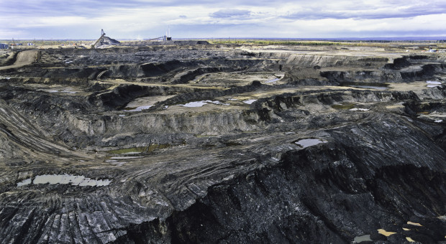
The Case of Alberta
In 1947, oil and natural gas reserves were discovered in Alberta. When oil prices skyrocketed in 1973 and 1979, Alberta wanted to sell at world prices. The federal government issued a policy to stabilize domestic prices and forced Alberta to sell to other provinces at lower prices, causing additional resentment between east and west.
Alberta’s sand oil

Slide 21
IV. Agriculture
Background
88% of the landmass is unsuitable for farming
soil is poor, the growing season is short and the climate is harsh
farming concentrates on a narrow band along the southern border
products are far away from the metropolitan markets, transportation costs expensive

Slide 22
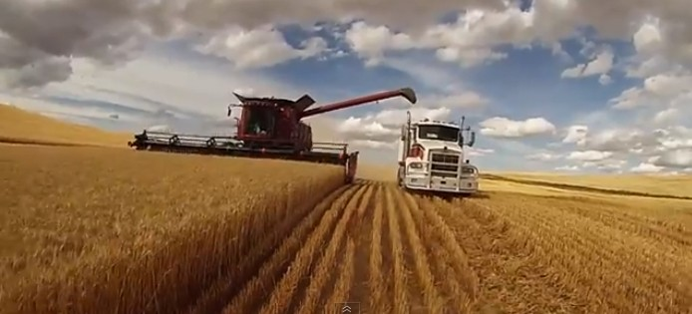
Production Base
-- the prairie provinces
account for about 51% of agricultural output
specialize in wheat and cereals, feedstock and cattle
farms tend to be very large

Slide 23
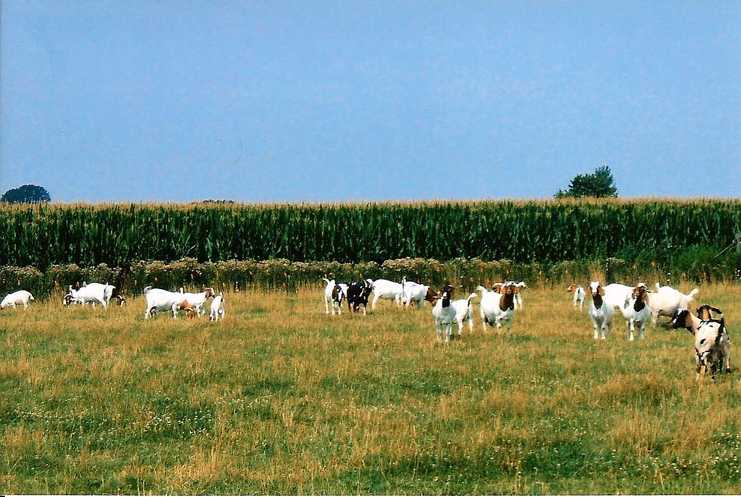
Production Base
-- Quebec & Ontario
had more than 3/4 of Canada’s dairy farms and 2/3 of hog farms (1981)
farms are much smaller

Slide 24
Production Base
-- New Brunswick and PEI
large poultry sectors specializing in potato production
-- British Columbia
mild climate good for orchards,
and the development of a wine industry

Slide 25
Government policies and FTA
federal government introduced a subsidy policy in World War II, reducing transportation costs and allowing regions to specialize in products
Impact of FTA
-- a dramatic drop in exports
-- cheaper to import and buy from the US
-- displaced inefficient Canadian farmers

Slide 26
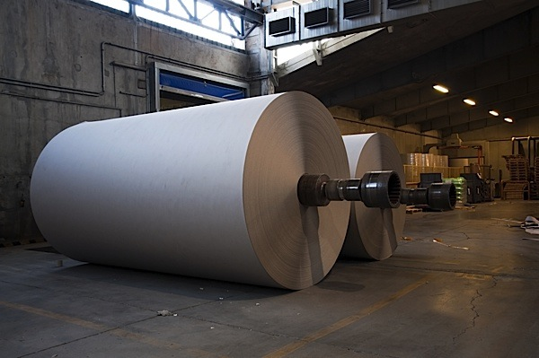
V. Manufacturing Industries
export raw resources and import manufactured goods
a high degree of foreign ownership
manufacturing products include –
paper, technological equipment, automobiles, food, clothing etc.

Slide 27
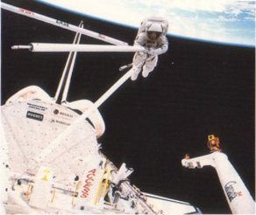
Advanced Technology
nuclear technology for peaceful means, eg. CANDU heavy water nuclear reactor
hydroelectricity production
telecommunications, e.g. Involved in developing the Chinese telecommunications industry
contributed to the American space program by providing a robotic arm (the “Canadarm”) to space shuttles

Slide 28
VI. Service Industries
include banking, health care, construction, communications, education, tourism and government
over 70% of Canadians work in the service sector
export of services through forums like GATT and FTA
Graduation Ceremony at McGill University

Slide 29
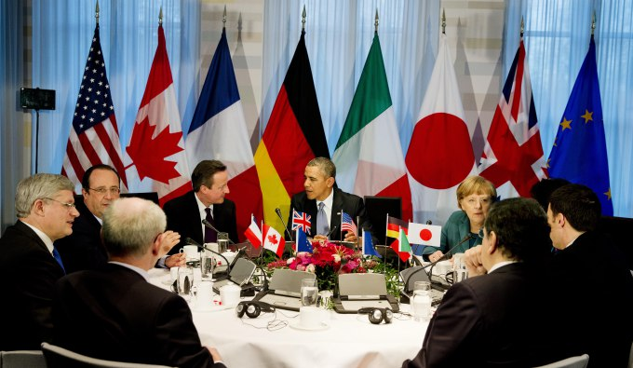
VII. Canada’s Place In The World Economy
influences the world economy as one of the wealthy industrialized countries
growth rate high among the G-7 countries
its strong macroeconomic frameworks, conservative bank lending policies and strict regulation, and a cautious business culture -- helped reduced the impact of the world financial crisis

Slide 30
Questions for Discussion
Comment on the sentence "As is the case in other industrialized countries, more Canadians now provide services than make things".
Do you think the Canadian government should subsidize the inefficient Canadian farmers so as to protect its agriculture from the competition from the US?
How do you view the future of freer trade among nations in the world? Will this result in diminishing national identity and sovereignty?
What do you think of the FTA? Is it beneficial to Canada as it is to the United States?

Slide 31
The End
高等教育出版社
2015

